Slide 1
Relief in Cross-Border Insolvency and Maritime Law

Slide 2
Principles of the Model Law
Comity Uniformity Flexibility

Slide 3
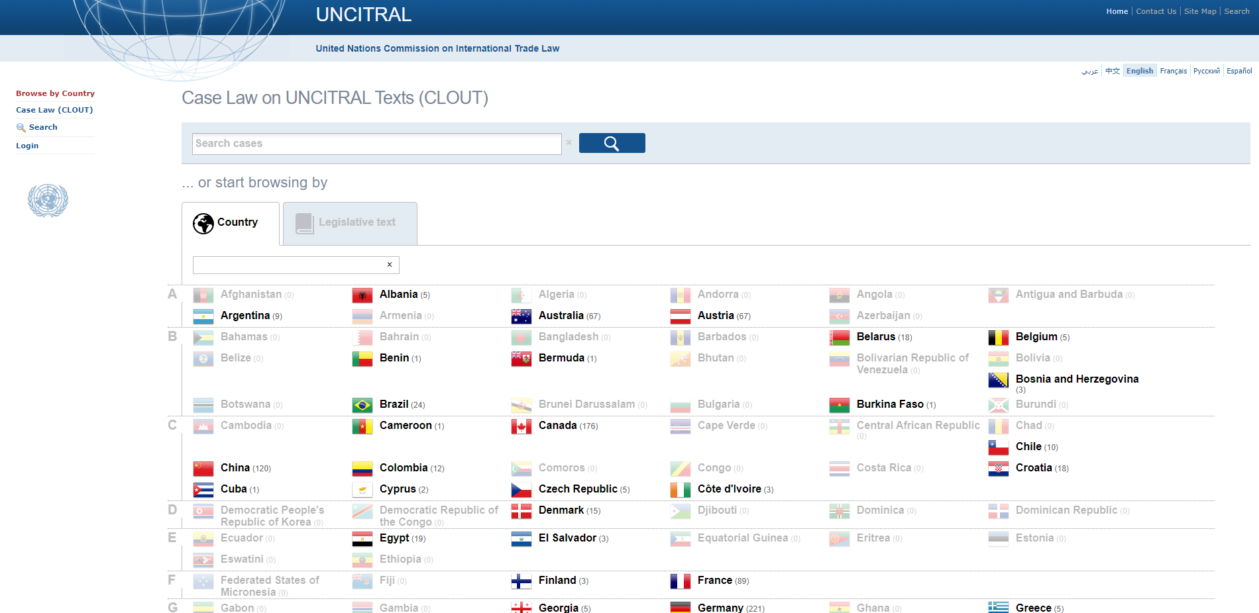
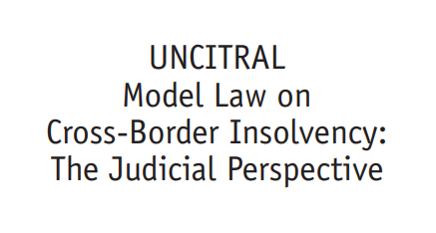
United Nations Commission on International Trade Law (UNCITRAL) Model Law on Cross-Border Insolvency (1997)
“Case Law on UNCITRAL Texts (CLOUT)” (UNCITRAL) < https://uncitral.un.org/en/case_law>.

Slide 4
Pre-Model Law case
Turners & Growers Exporters Ltd v Cornelis Verlome (1996) 1 BCSLR 334 350

Slide 5
In practical terms?
in practical terms, no single
approach is possible or
desirable.
Judicial Perspective, Introduction.

Slide 6
Four elements of the Model Law
Access
Recognition
Relief
Cooperation and Coordination
Judicial Perspective, at [14].

Slide 7
Relief
(a) Interim (urgent) relief that can be sought at any time after the application to recognize a foreign proceeding has been made (Article 19);
(b) Automatic relief consequent upon recognition of a foreign proceeding as a “foreign main proceeding” (Article 20); and
(c) Discretionary relief consequent upon recognition of the foreign proceedings as either a main or non-main proceeding (Article 21).
Judicial Perspective, at[144].

Slide 8
Clash of the Titans

Slide 9
Interim Relief
So a court that grants interim or final relief under arts 19 or 21 respectively must work out what the local equivalent is of the foreign proceeding it is being asked to recognize: ie, the court must decide, first, whether secured creditors keep their rights or those rights will be suspended in the forum and be determined in the foreign proceeding and, secondly, what is the closest local equivalent for the foreign insolvency process so that the stay under Art.20 will reflect, in the most analogous manner, the nature of the protection that the debtor actually has in the foreign jurisdiction and should have under the local insolvency law.
Rares, Justice Steven “Ship arrests, maritime liens and cross-border insolvency” (FCA) [2017] FedJSchol 21 p 412.

Slide 10
Adequate Protection

Slide 11
Treatment: Case Law
Yu v STX Pan Ocean Co Ltd (South Korea) [2013] FCA 680
Any application for the issue of a warrant of arrest in Australia of any vessel owned or chartered by the defendant be dealt with by a Judge of this Court and these Reasons for Judgment be drawn to the attention of the Court at the time any such application is made.
Order 7

Slide 12
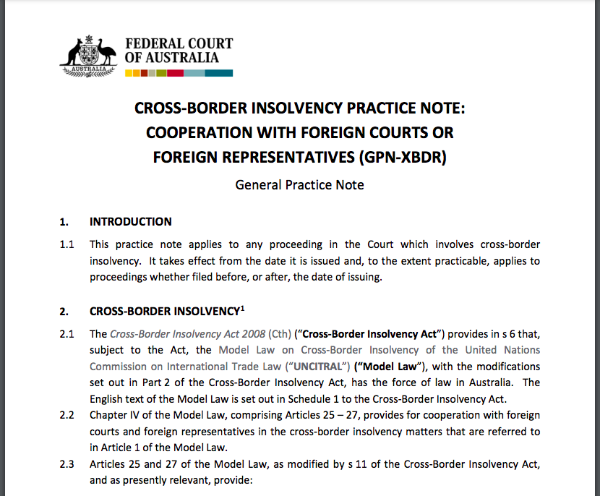
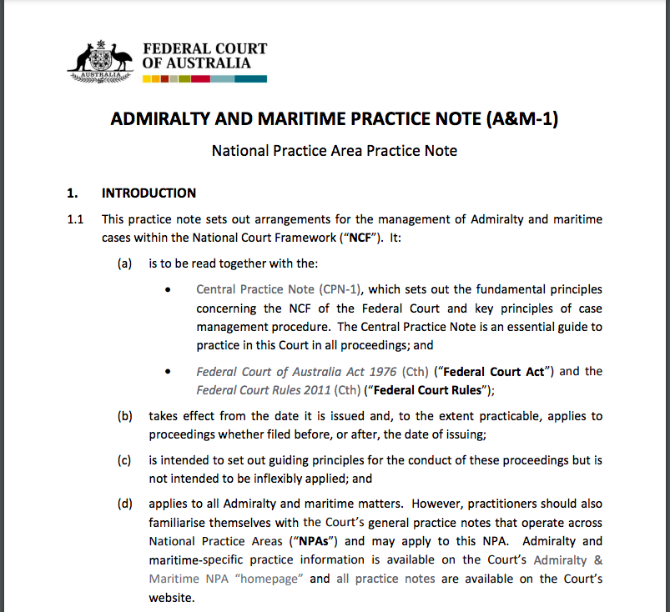
Practice Notes

Slide 13
What a relief!

Slide 14
Thank you

