Slide 1
IWG on the Restatement of the Lex Maritima
MONTREAL, QUEBEC, CANADA, 16TH JUNE 2023

Slide 2
D.1.4.40 (Modestinus): Ergo omne ius aut consensus fecit, aut necesitas constituit, aut firmavit consuetudo

Slide 3
Members of the IWG
Eric Van Hooydonk (Belgium), Chairman
Jesús Casas (Spain), Rapporteur
Lijun Zhao (China)
Michael Sturley (USA)
Tomotaka Fujita (Japan)
Andreas Maurer (Germany)
Alexander von Ziegler (Switzerland)
Mišo Mudrić (Croatia)
Werner Braun Rizk (Brazil)
Massimiliano Rimaboschi (Italy)
Bernardo Melo Graf (Mexico)
Eduardo Adragna (Argentina)
Javier Franco (Colombia)
Kerim Atamer (Turkey)
Aybek Ahmedov (Russia)
Andrea La Mattina (Italy)
Frank Smeele (The Netherlands)
Olivier Cachard (France)
Luiz Roberto Leven Siano (Brazil)
Filippo Lorenzon (UK/Italy)
Gustavo Omaña (Venezuela)

Slide 4
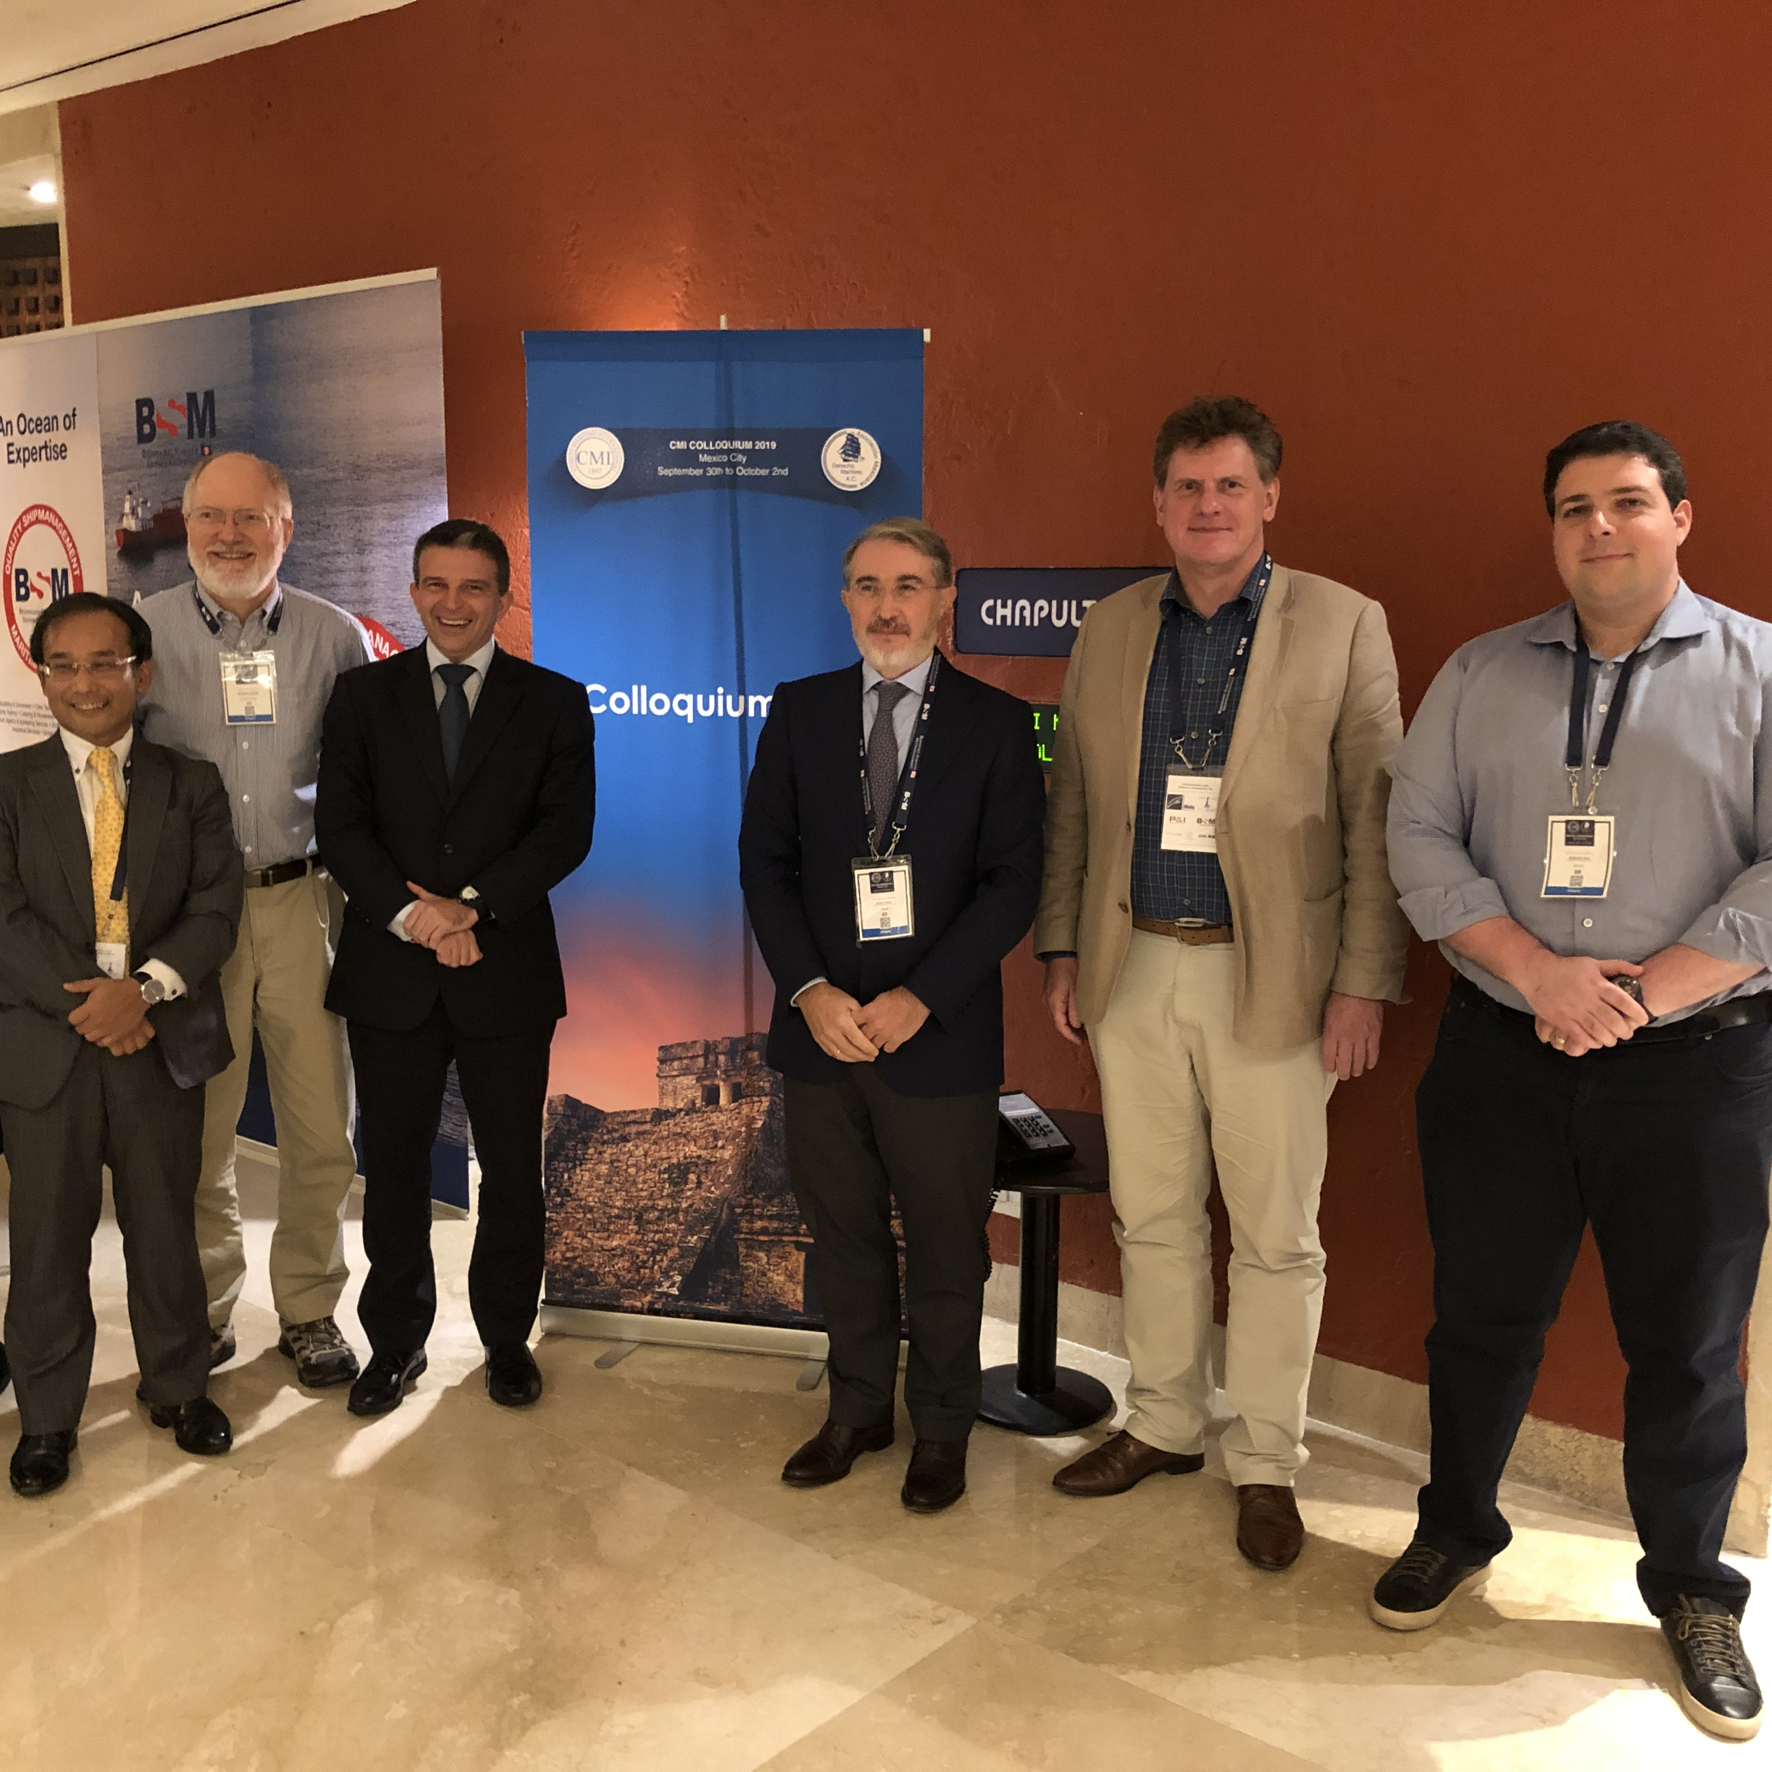
Time-line (1)
The IWG was established by the ExCo in 2014 (Istanbul)
Constantinopolis, same city where the Compilation of Justinian was made
Meetings of the Group were held in New York 2016, London 2018 and Mexico City 2019

Slide 5
Time-line (2)
During the New York Conference, on 4 September 2016, a one-hour session was devoted to the subject, co-chaired by Eric Van Hooydonk and Michael Sturley.
The objective of the project is the compilation of selected principles of the Lex Maritima.
On 6 September 2016, support to the IWG was given by judges James Alsop and Johanne Gauthier in their 13th Nicholas J. Healy lecture on admiralty law delivered at the NYU School of Law.

Slide 6
Time-line (3)
See CMI’s Yearbook 2015, page 432 and 2016, page 260
Some members published articles on the subject
Ten draft documents have been worked out, starting from a simple list and ending in 30 principles
The 8th Draft was publicly presented at Antwerp (125th Anniversary of the CMI and home town of our Chairman)
In 2023 four videoconferences led to our “Montreal Draft”

