Slide 1
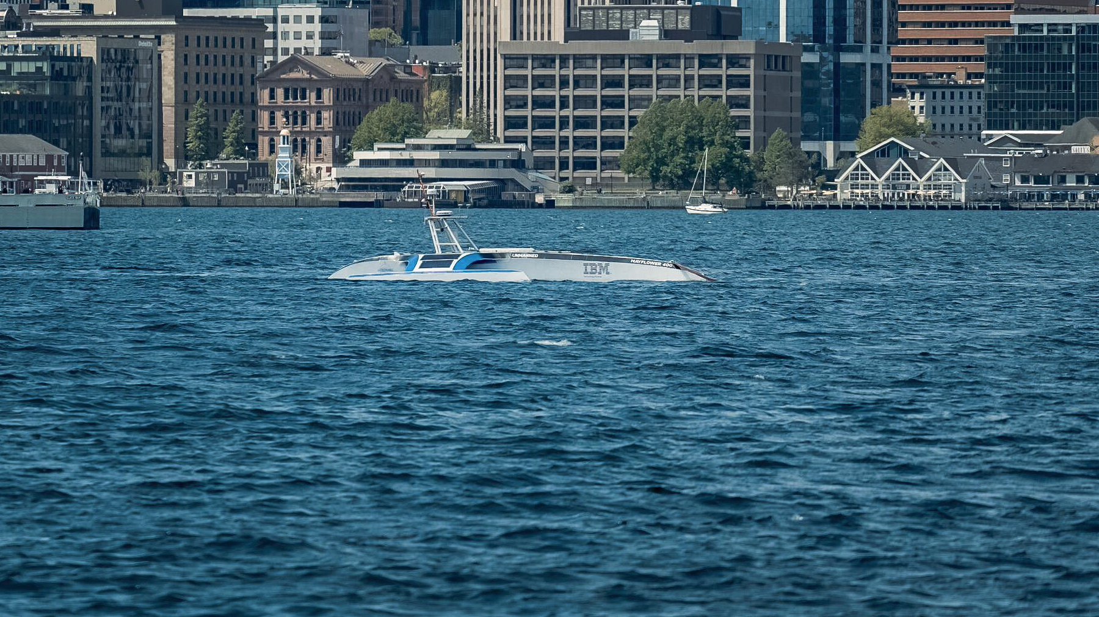
MASS - NAVIGATING A PATH TROUGH ISSUES OF LIABILITY
The Arrival of the Mayflower in Halifax, Nova Scotia, 5 June 2022

Slide 2
MASS - NAVIGATING A PATH THROUGH ISSUES OF LIABILITY
AUTONOMOUS SHIPS AND THE COLLISION REGULATIONS
All vessels, (manned or unmanned) must follow Colregs
Rule 2(b)
“In construing and complying with these Rules due regard shall be had to all dangers of navigation and collision and to any special circumstances, including the limitations of the vessels involved, which may make a departure from these Rules necessary to avoid im”mediate danger”.
Master must depart from Colregs if he sees with “perfect clearness” that adhering to the rule will bring about a collision and violating a rule will avoid it.

Slide 3
MASS - NAVIGATING A PATH THROUGH ISSUES OF LIABILITY
AUTONOMOUS SHIPS AND THE COLLISION REGULATIONS
Navigation system will be expected to meet standards of prudent seamanship
In some circumstances a departure from COLREGS will be a duty in certain circumastances
If the navigation system is self learning it will be impossible to interrogate the reason for its decision
Query – Will MASS be held to a different and higher standard since there is no need to protect the lives of anyone on board?

Slide 4
MASS - NAVIGATING A PATH THROUGH ISSUES OF LIABILITY
COLLISION AND THE LAW OF TORT
Need to establish a failure to take reasonable care (Donoghue v Stevenson)
And a need to establish which human agencies were responsible and whether their faults are attributed to the Owner (Vicarious Liability)
Question is whether the wrongdoer was acting as servant or agent of the Owner
The development of AI is not within the control of the Owner. It is not possible to understand how the system has made a decision (“Black Box AI”)

Slide 5
MASS - NAVIGATING A PATH THROUGH ISSUES OF LIABILITY
PROPORTIONATE FAULT RULE
Nick Healy (Snr) on the Proportionate Fault Rule
“It makes little sense to say that in the event two vessels are at fault, each must be held strictly liable to the other and pay 100% of the other’s damages”

Slide 6
MASS - NAVIGATING A PATH THROUGH ISSUES OF LIABILITY
STRICT LIABILITY
Absolute liability for damage caused by an act even though the damage is the result of pure accident or another person’s wrongdoing and is neither intentional nor negligent
Where there is a collision involving a degree 4 MASS it may be appropriate as it will be difficult or impossible to determine fault when the navigation is by AI
Shipping is familiar with strict liability:
CLC Convention
2002 Protocol to Athens Convention (which has exemption from strict liability where the incident “wholly caused …by a third party”)

Slide 7
MASS - NAVIGATING A PATH THROUGH ISSUES OF LIABILITY
WHY STRICT LIABILITY?
The change is only that the Owner has the burden of proving he did not cause the loss
Owner has the benefit of Limitation under LLMC which will not be available to developer of AI
There are major barriers to Third Parties claiming against developers.
Insurance issues

Slide 8
MASS - NAVIGATING A PATH THROUGH ISSUES OF LIABILITY
However ….
If the Owner is strictly liable this may encourage sloppiness in the AI developer
There will be occasions where it will be unjust to hold the MASS owner liable
Possible solution would be to reverse the burden of proof?
Put burden on Defendant to prove he was not negligent

